Slide 1
*DataBridge Education*
A Data Warehousing Project

Slide 2
Project Overview
- Development of a data warehousing system for educational data.
- Utilized SQL Server Management Studio (SSMS) and Power BI.
- Focused on ETL processes using SQL Server Integration Services (SSIS).

Slide 3
Problem Domain
- Need for efficient data management in the education sector.
- Traditional databases insufficient for growing data volume.
- Requirement for a data warehouse to support analysis and reporting.

Slide 4
Project Objectives
- Create a scalable data warehousing solution.
- Enable complex queries and reporting efficiently.
- Provide insights through Power BI visualizations.

Slide 5
System Architecture
- Data Sources: Educational records, attendance, and grades.
- ETL Processes: Managed via SSIS.
- Data Warehouse: SQL Server with star schema.
- BI Layer: Power BI for reporting.

Slide 6
Implementation Overview
- Created SQL Server database with star schema design.
- Used SSIS for ETL processes to load data.
- Ensured data integrity and consistency.

Slide 7
Validation
- Conducted unit tests on ETL processes.
- Assessed query performance for responsiveness.
- Engaged users for acceptance testing.

Slide 8
Future Work
- Improve scalability for larger datasets.
- Incorporate advanced analytics and machine learning.
- Enhance user interface based on feedback.

Slide 9
Conclusion
- Successfully established a data warehousing system for education.
- Achieved efficient reporting and data integrity.
- Provided actionable insights through Power BI.

Slide 10
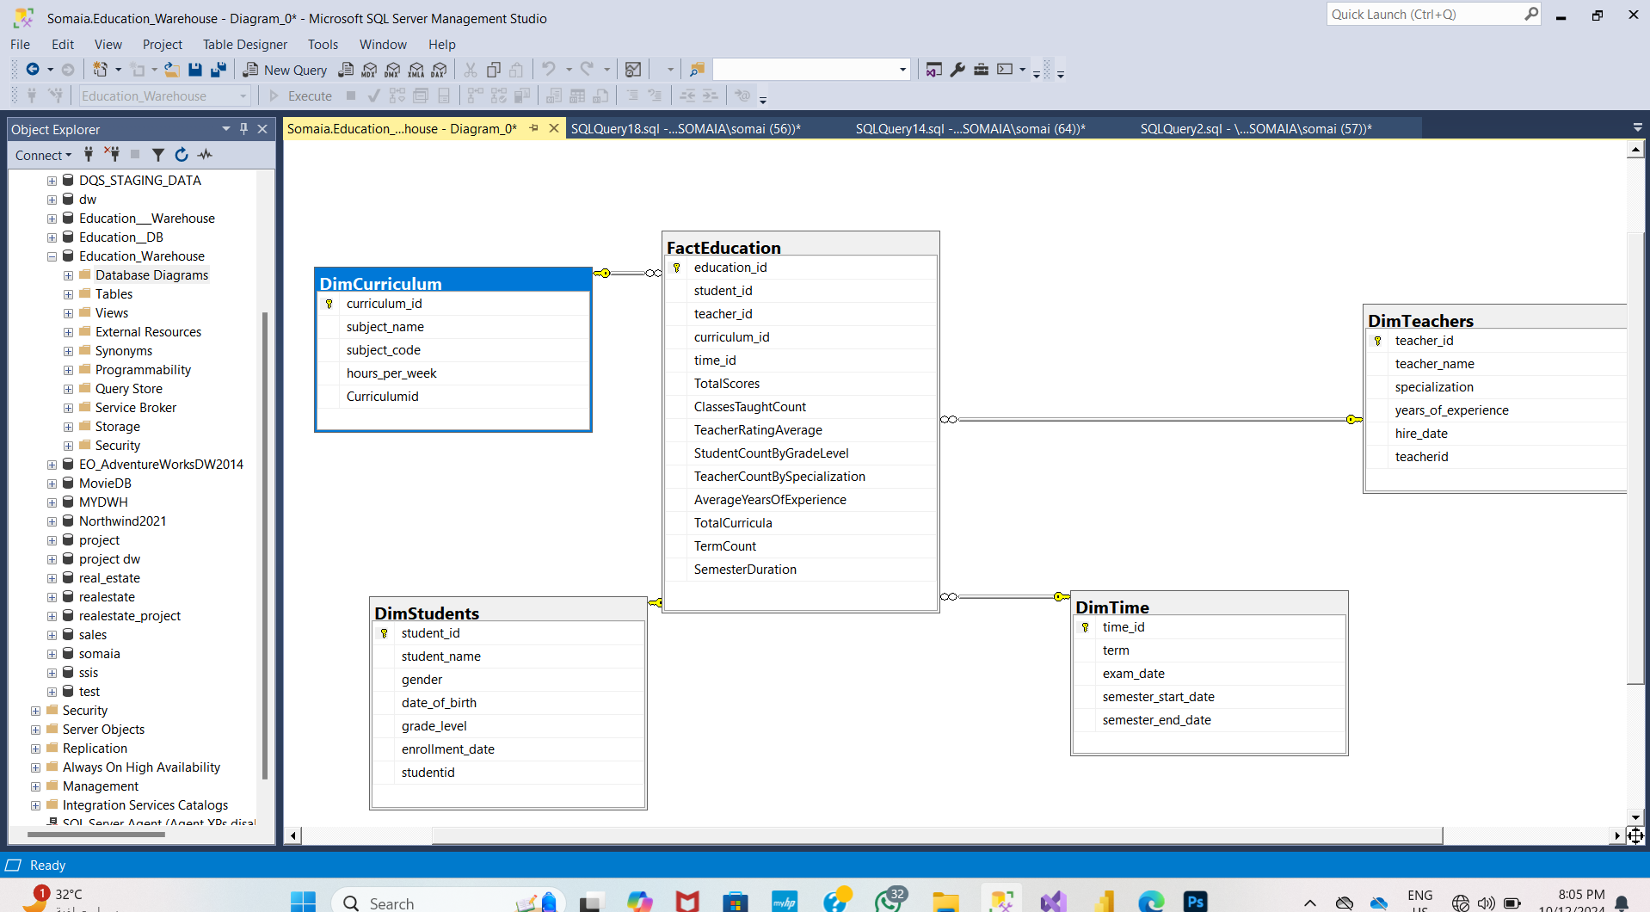
Parts of our work create star schema

Slide 11
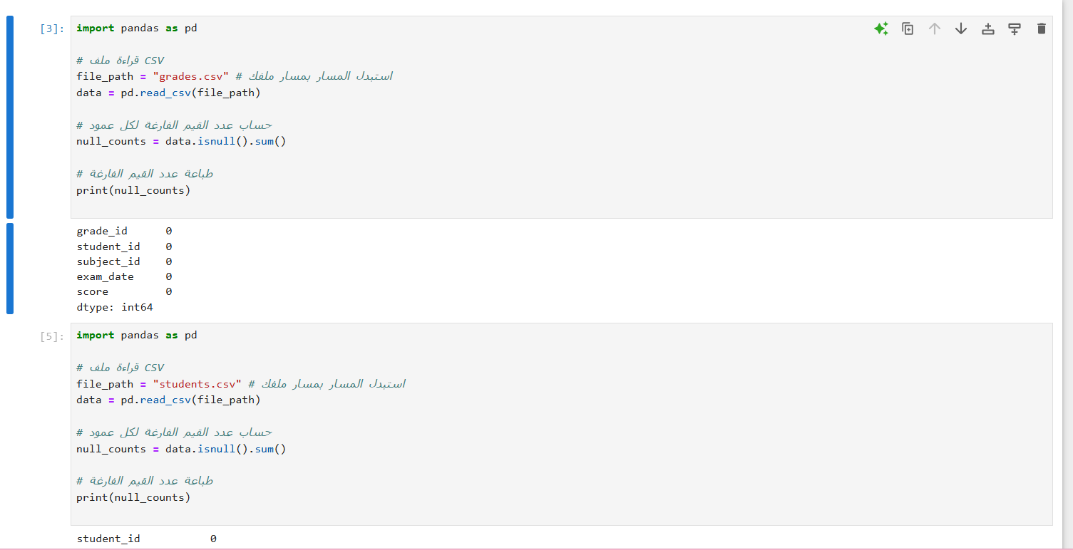
Check if the part of the data is clean

Slide 12
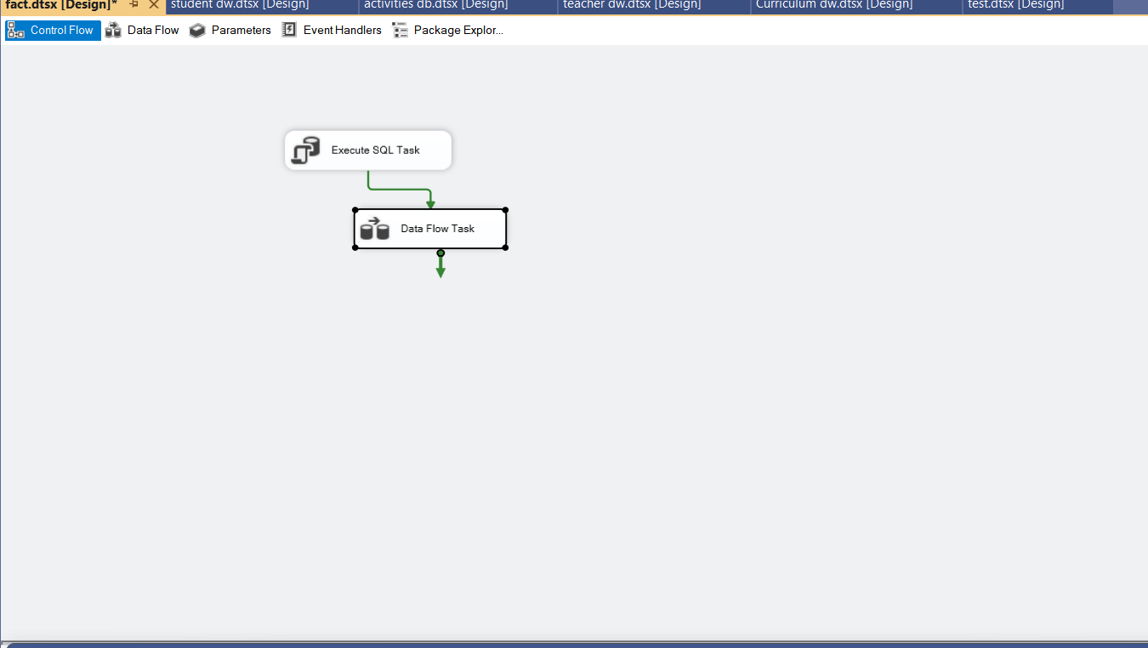
Etl process fact

Slide 13
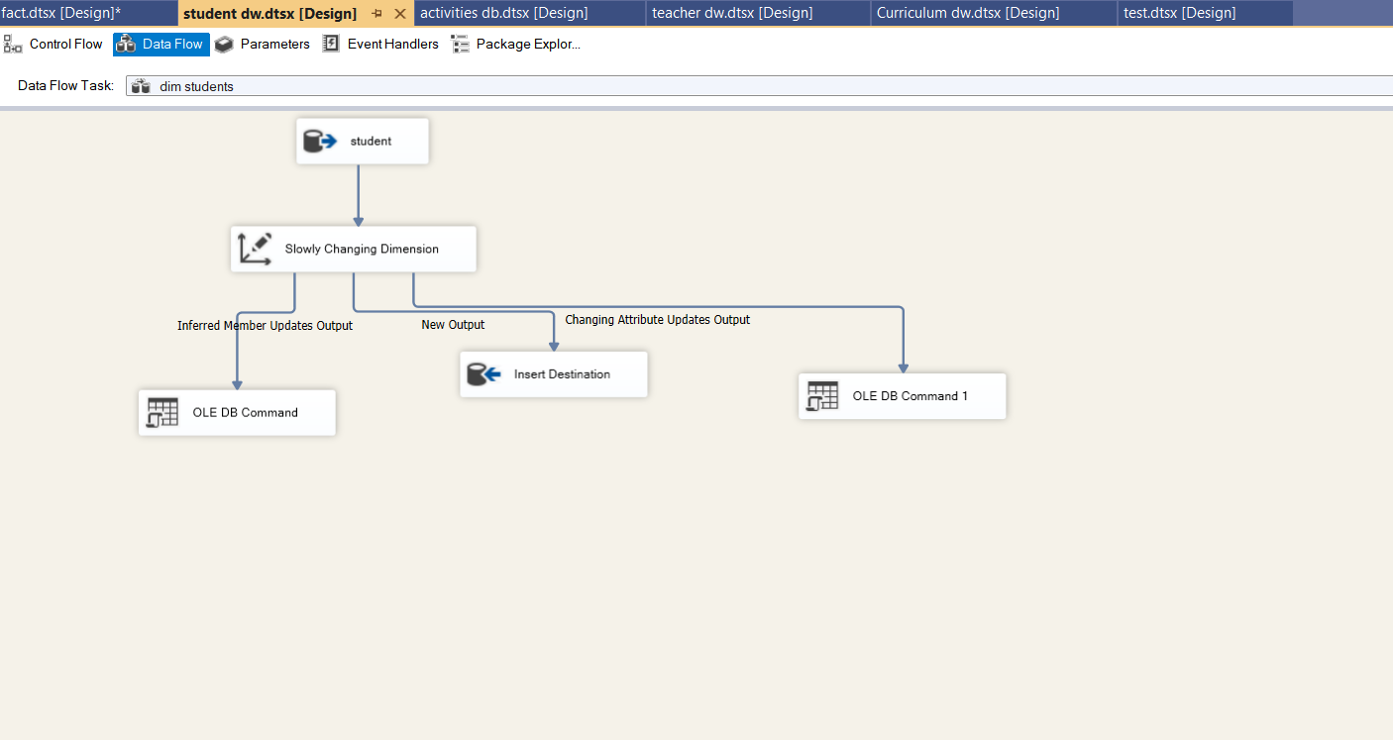
Etl :student

Slide 14
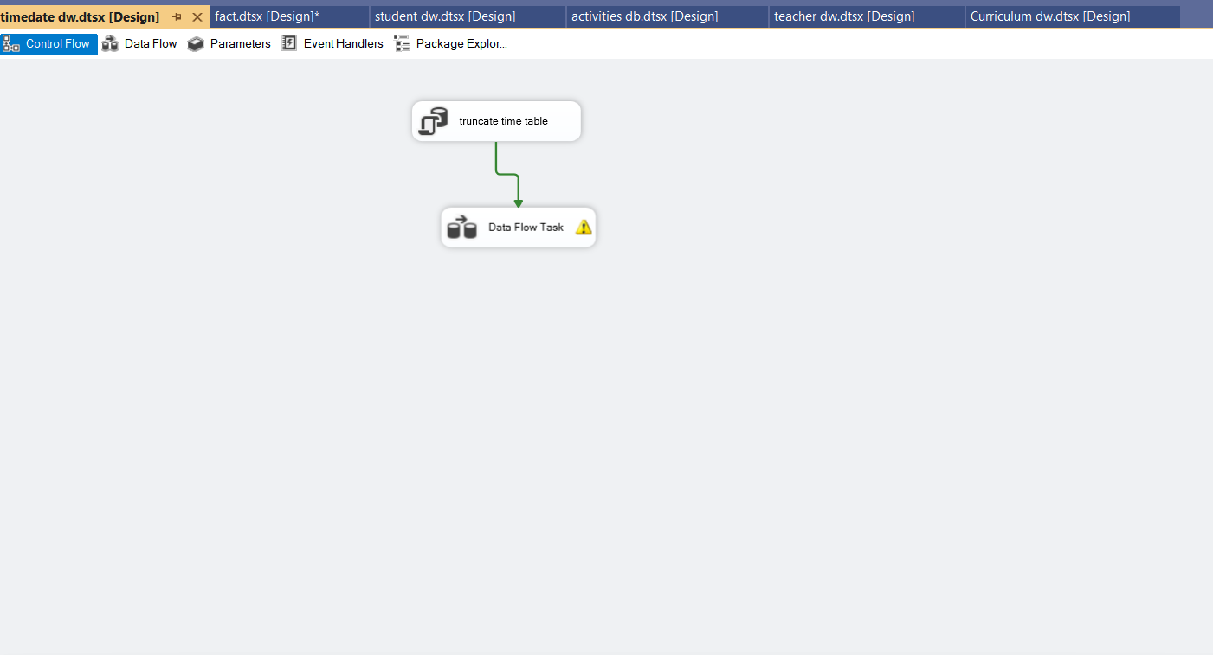
Etl : time

Slide 15
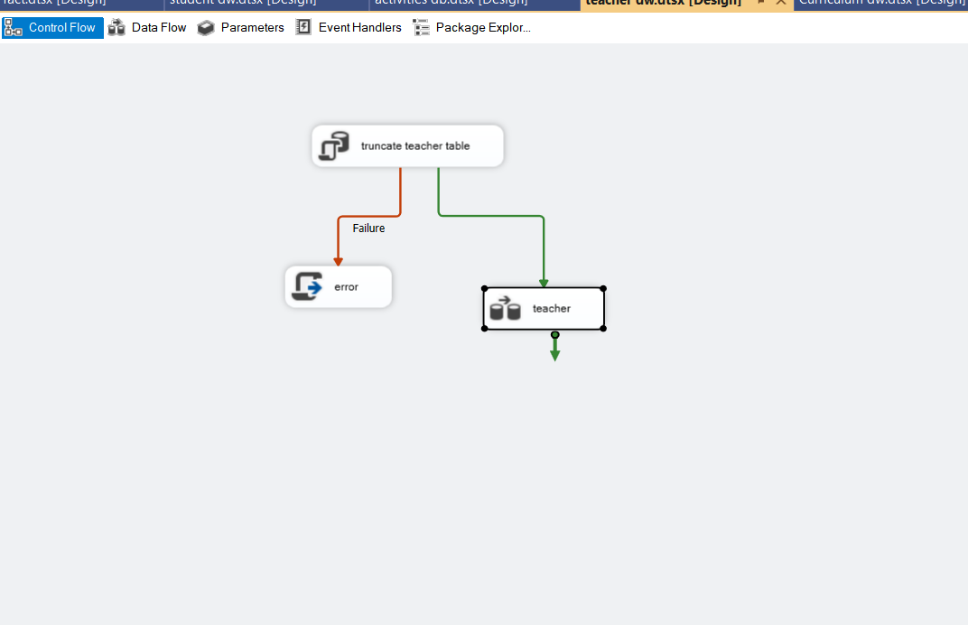
Etl:teacher

Slide 16
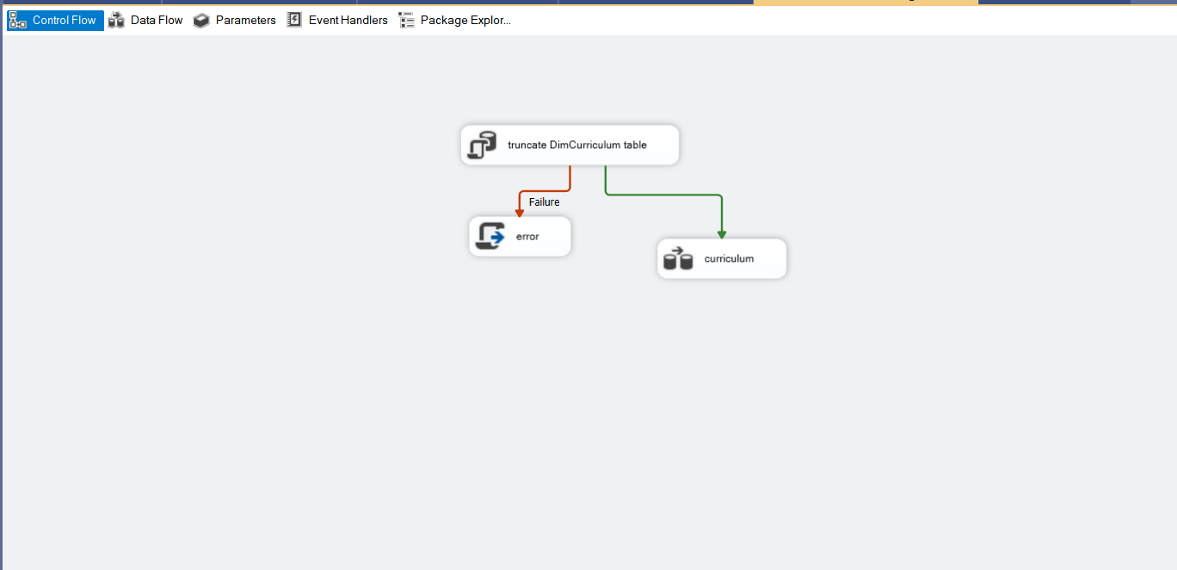
Etl:subjects

Slide 17
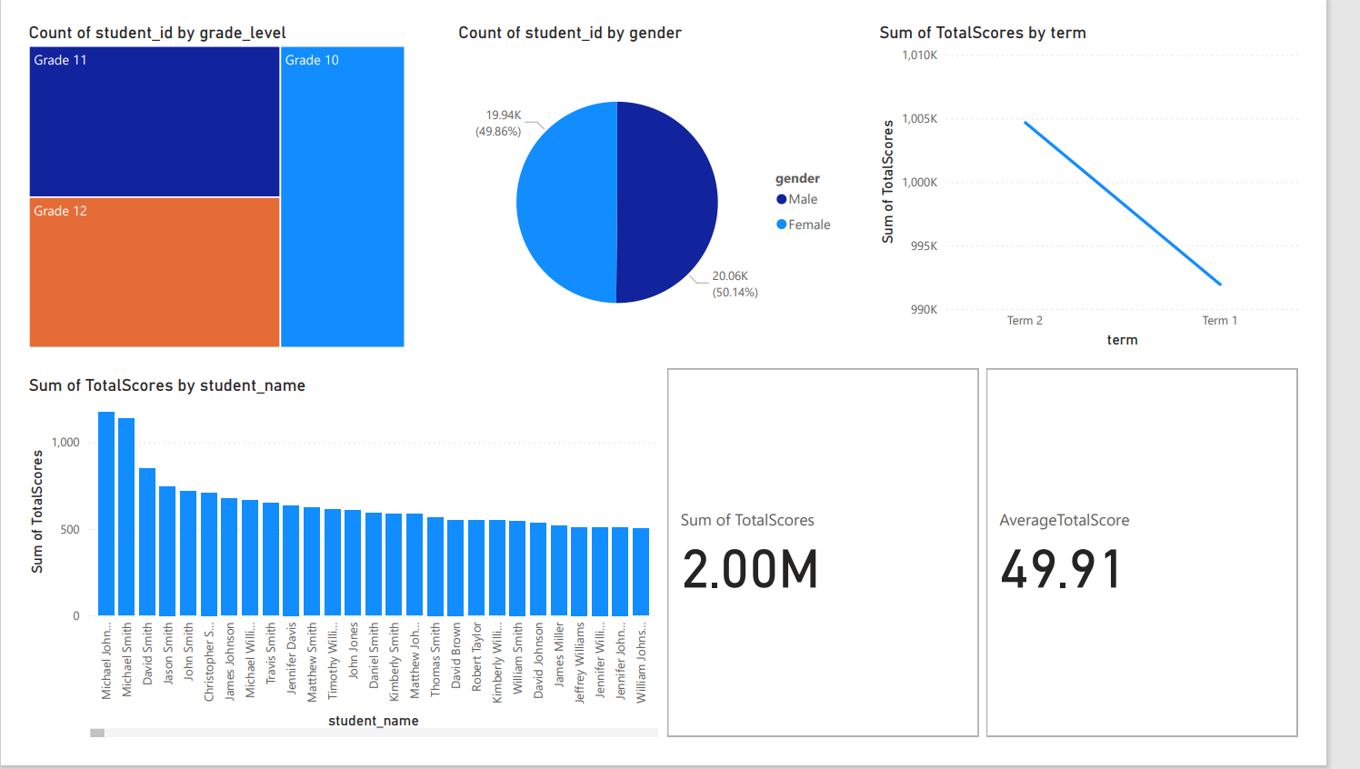
Power bi

Slide 18
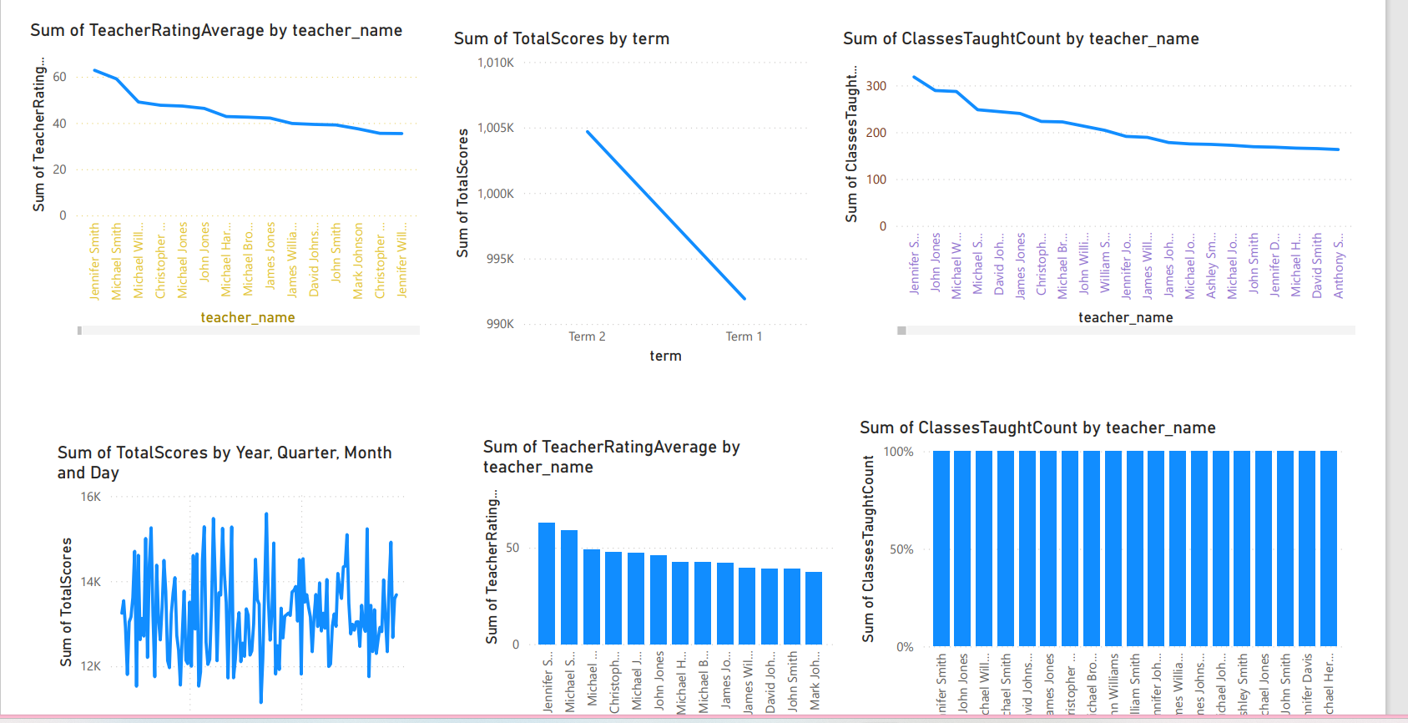
Power bi

Slide 19
1. Count of Student ID by Grade Level
Explanation: This metric counts the number of students enrolled in each grade level by counting the "Student ID" per grade level.
Benefit: It helps analyze student distribution across different grade levels, which can highlight areas that may need more resources or curriculum improvements.

Slide 20
2. Count of Student ID by Gender
Explanation: This metric counts the number of students based on gender (male/female) by counting the "Student ID" grouped by gender
Benefit: It provides reports on student distribution by gender, useful for analyzing performance differences or ensuring balance in classrooms.

Slide 21
3. Sum of Total Score by Term
Explanation: This sums up the final scores of students for each academic term by aggregating the "Total Score" across different terms.
Benefit: It helps track overall student performance per term, providing insights into academic progress or decline over time.

Slide 22
4. Sum of Total Score by Student Name
Explanation: This metric sums the total scores by student name, providing the total scores each student has achieved.
Benefit: It offers an individual assessment of students' performance over the academic period and can be used in reporting to parents.

Slide 23
5. Sum of Total Scores, Average Total Scores
Explanation: This includes both the total and average of students' scores. It calculates the sum of scores and then derives the average.
Benefit: It gives an overall view of the academic performance of students and allows for comparison across different time periods or grade levels.

Slide 24
6. Sum of Classes Taught Count by Teacher Name
Explanation: This sums the number of classes taught by each teacher. It aggregates the "Class Taught Count" for each teacher.
Benefit: It helps assess the workload of each teacher and track the distribution of classes, enabling the management to monitor teacher performance and workload distribution

Slide 25
7. Sum of Teacher Rating Average by Teacher Name
Explanation: This metric calculates the average teacher rating based on the teacher's name. It aggregates and averages the rating scores for each teacher.
Benefit: It provides insights into teaching quality based on ratings from students or administration, aiding in decisions regarding recognition or professional development.

Slide 26
8. Sum of Total Scores by Year, Quarter, Month, and Day
Explanation: This sums the total scores based on specific time frames (year, quarter, month, day), aggregating scores for these periods
Benefit: It helps understand student performance over different time intervals, offering detailed analysis of academic progress over time (annually, quarterly, monthly, daily).

Slide 27
9. Sum of Classes Count by Teacher Name
Explanation: This metric sums the number of classes taught by each teacher.
Benefit: It provides an overview of the teaching workload for each teacher, helping assess
class distribution and resource allocation

